Slide 1

Customer Experience … but Why ???
5-x more likely to R-E-P-U-R-C-H-A-S-E
5-x more likely to F-O-R-G-I-V-E
4-x more likely to R-E-F-E-R
7-x more likely to T-R-Y new offerings
Use NPS to track Customer LOYALTY
Distribute CSAT Surveys to understand Customer SATISFACTION
Send CES Surveys to analyze Customer EASYNESS for the support they need

Slide 2
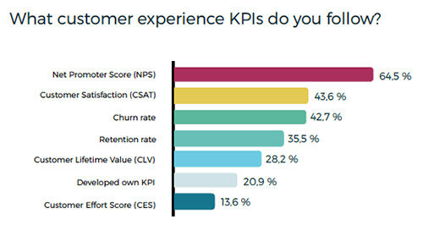
Own KPIs may include
Average Time to Resolution
First Contact Solution
Customer Engagement
Task Completion Rate
Social Listening
Referral Rate

Slide 3
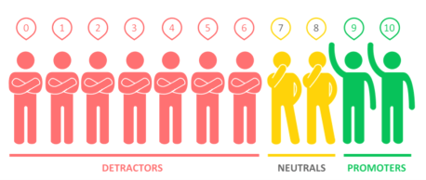
NPS (Net Promoter Score)
Client : Dell Computers (US) – Technical Support
Mission : Initiate and establish CX program to check customer’s loyalty
Increase Sales
Pre-work : Established current NPS at 21%
Recorded Sales-per-Call at US$2.43
Industry Standards : 35+
Planned and initiated NPS Program (starting initial 6-months) for the next 1.5 Years
NPS of 25+
Increase Sales-per-Call to US$2.75
Multi-channel Surveys (Email, SMS, IVR, Phone-calls)
New Learning(s)
Smooth customer journey process
First Call Solution with less Average Time Resolution
Ready-made guide for similar problems with videos
Recommended purchase (preferred and alternate) to increase Sales
Outcome (after 1.5 Year)
NPS of 48+
Sales-per-Call at US$4.78
Reduced call volumes to contact-center by 32% saving 4.2Million US$
Returned customer for re-purchase increased by 42% boosting Sales

Slide 4
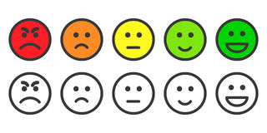
C-SAT (Customer Satisfaction)
Client : British Telecom (UK) – Customer Support
Goal : Establish C-Sat Report Card for their Internet-TV-Phone Services in UK & Ireland
Pre-work : Established current C-Sat score at 49%
Industry Standards : >=65%
Planned and initiated C-Sat Program (starting initial 6-months) for the next 1 Year
>=55% C-Sat Score
Take C-Sat scores within 30 Mins of a product or service being used
Multi-channel Surveys (Email, SMS, IVR, Phone-calls)
New Learning(s)
Smooth customer journey process
First call resolution generate better C-Sat scores
Ready-made guide for similar problems with videos
Recommended purchase (preferred and alternate)
Conclusion (after 1 Year)
C-Sat at >=69%
Referral Rate by existing customers increased by 15% (against 4% earlier)
Increased sales by existing customer rose to 27% (against 11% earlier)
Revenue increased by 43Million GBP

Slide 5
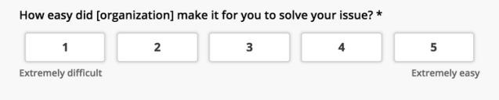
CES (Customer Effort Score)
Client : Optus Telecom (Australia) - Technical Support
Mission : Initiate CES Program to reduce Churn Rate and increase Retention Rate
Pre-work : Established current Churn Rate at 43%
Retention Rate at 57%
Industry Standards : 78%
Planned and initiated CES Program (starting with initial 6-months) for the next 1 Year
CES at >=65%
Reduce Churn Rate to 35% (from 43%)
Increase Retention Rate to 65% (from 57%)
New Learning
Analyzing distributions help find struggles during the process
Proactively fixing struggles decreases Churn Rate
94% customers with effortless experience are likely to repurchase
Reducing efforts likely to drive loyalty
Outcome (after 1 Year)
CES at >=77%
Churn Rate reduced to 21% (from 43%)
Retention Rate increased to 79% (from 57%)
Customer looking for convenient and speedy resolutions

Slide 6

Some interesting analysis … … … PwC Experience is Everything report revealed that 65 percent of U.S. customers are more persuaded by positive experiences with brands than great advertising Salesforce’s 2019 State of the Connected Customer report, 84 percent of consumers place just as much importance on the experience a brand provides as the product or service itself Gartner CEM study found that 75 percent of businesses show customer satisfaction leads to positive business outcomes, such as revenue growth, increased customer retention or increased lifetime value. Adobe's 2020 Digital Trends report found brands who effectively managed experiences were three times as likely to have exceeded their top company goals in 2019.
Do you want me to be a part of this great and exciting Customer Experience journey

